Slide 1

Project Title: Wikipedia Of Kerala
Section: K22GH
Group Members: Adhil Muhammed [12217308]
Anand Krishnan [12206276]
Minhaj Saleem [12214816]
Supervised By: Dr. Baljit Singh Saini
Submission Date: 21/11/2022

Slide 2
About Project
This project contains all the details about Kerala [Wikipedia of Kerala]. It contains several details about Kerala and has four external links about the same.
GitHub Link:-
Website Link:-

Slide 3
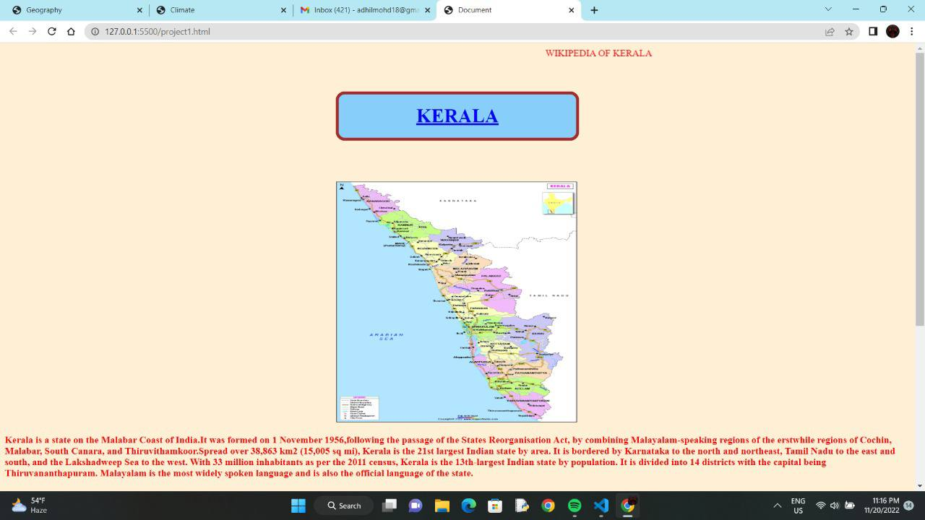
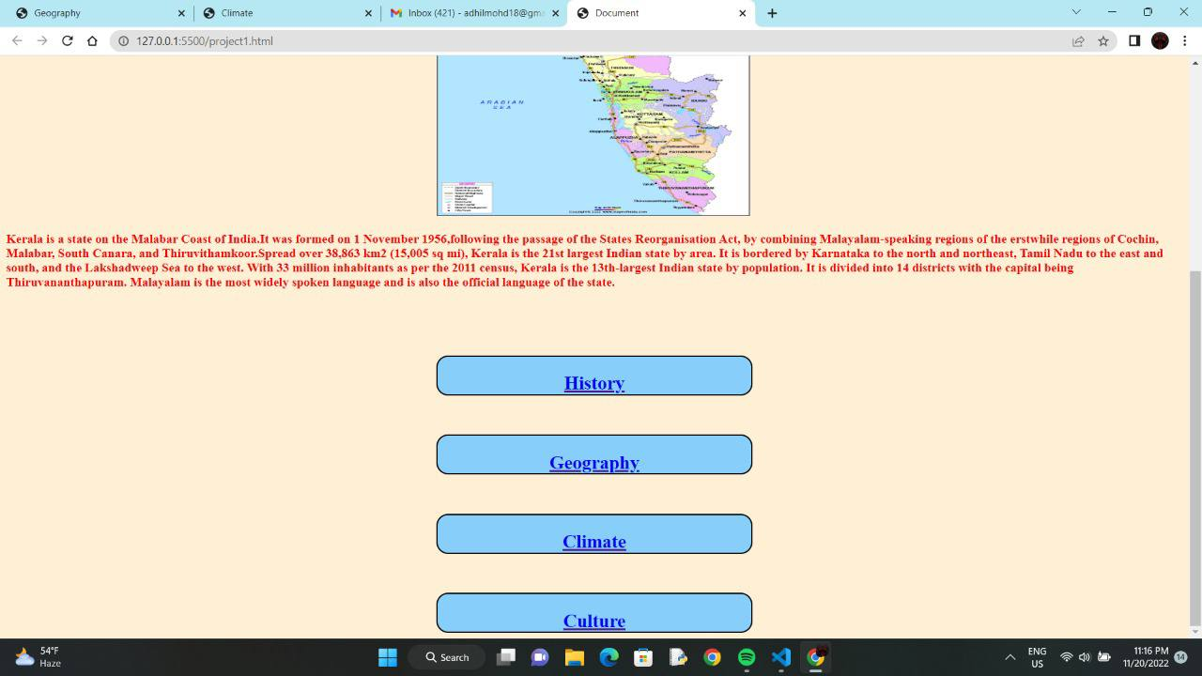
SNAPSHOTS

Slide 4
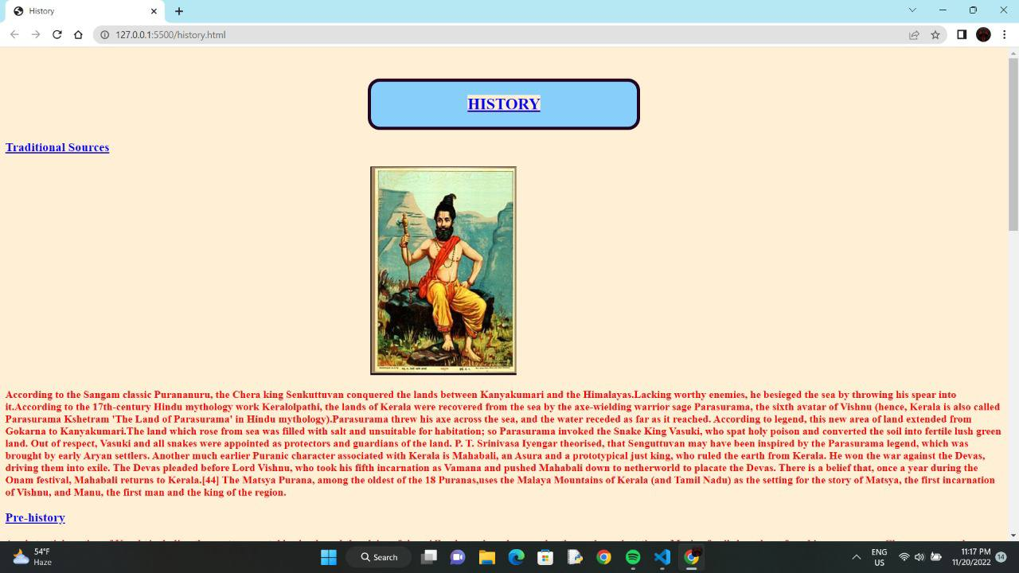
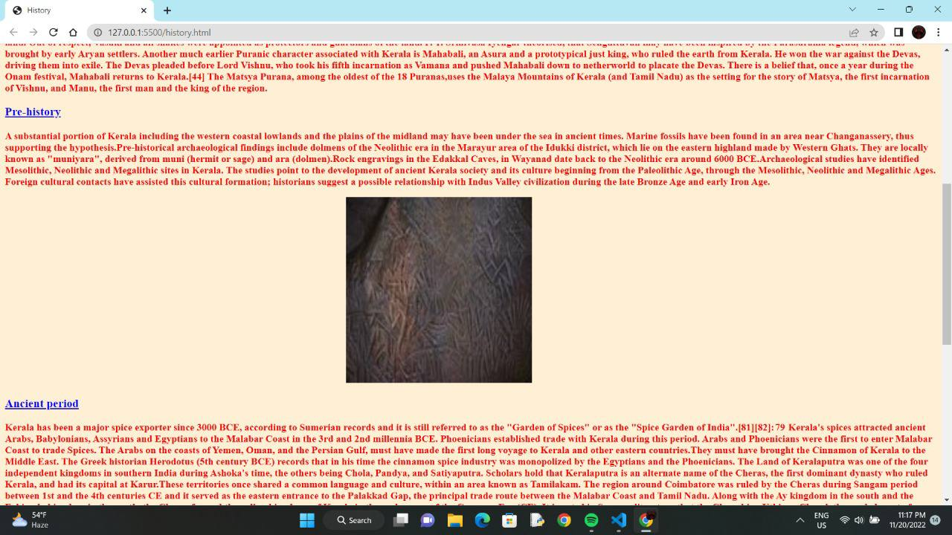

Slide 5
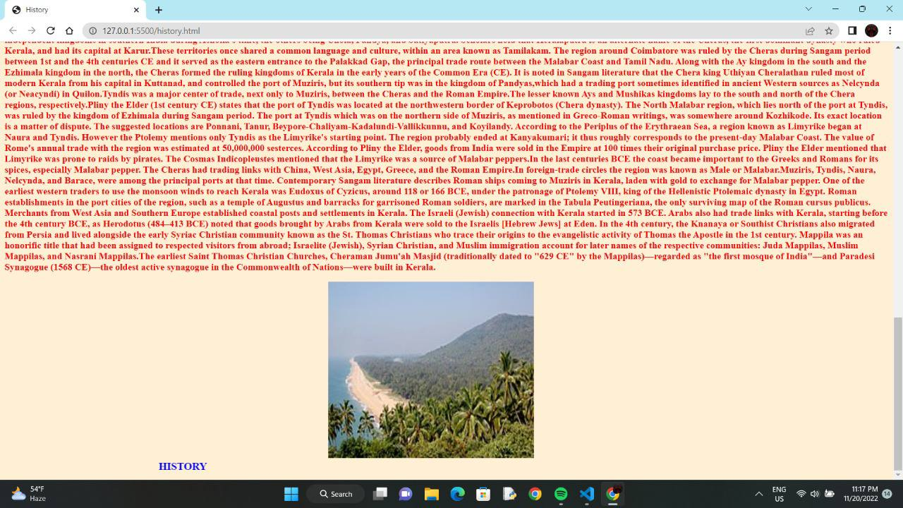
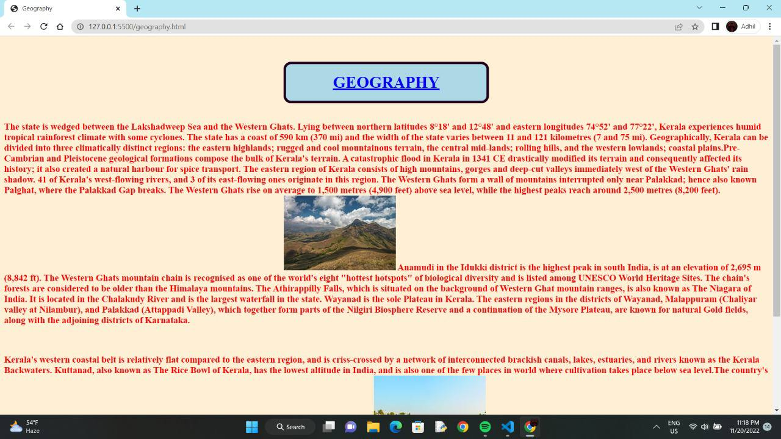

Slide 6
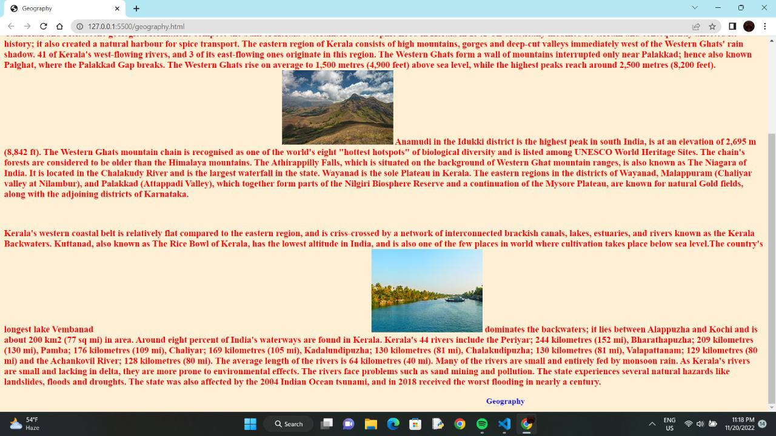
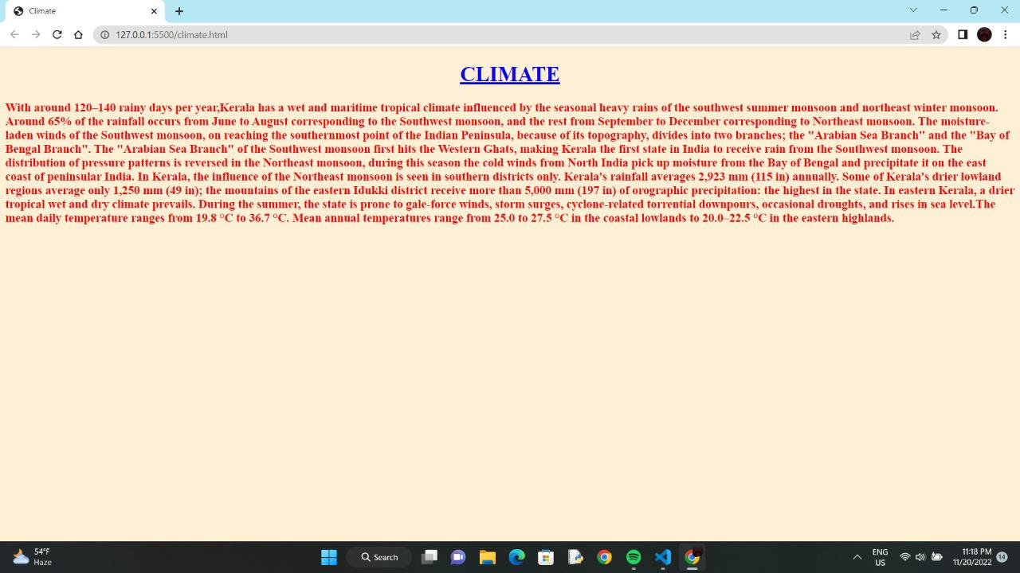

Slide 7
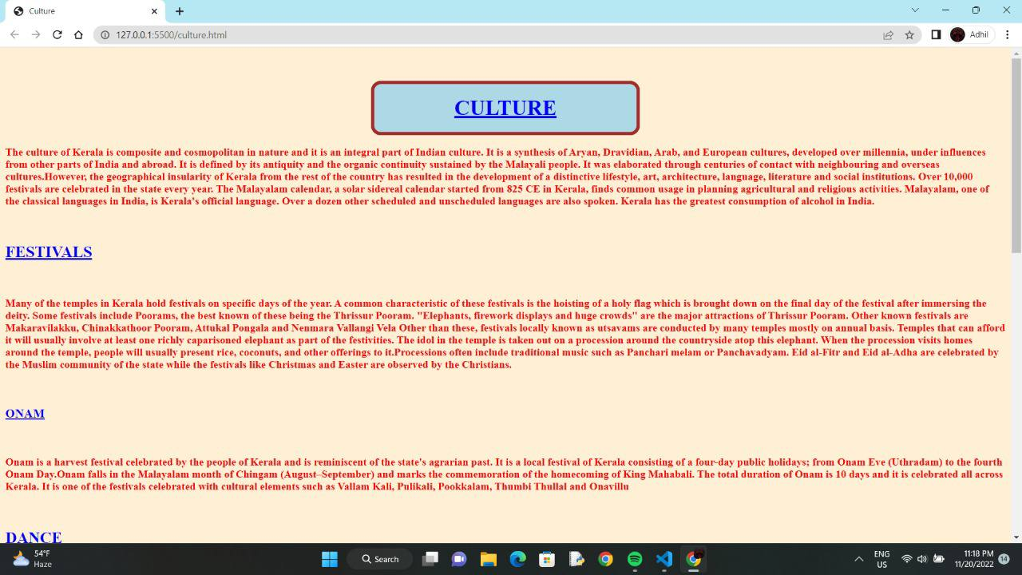
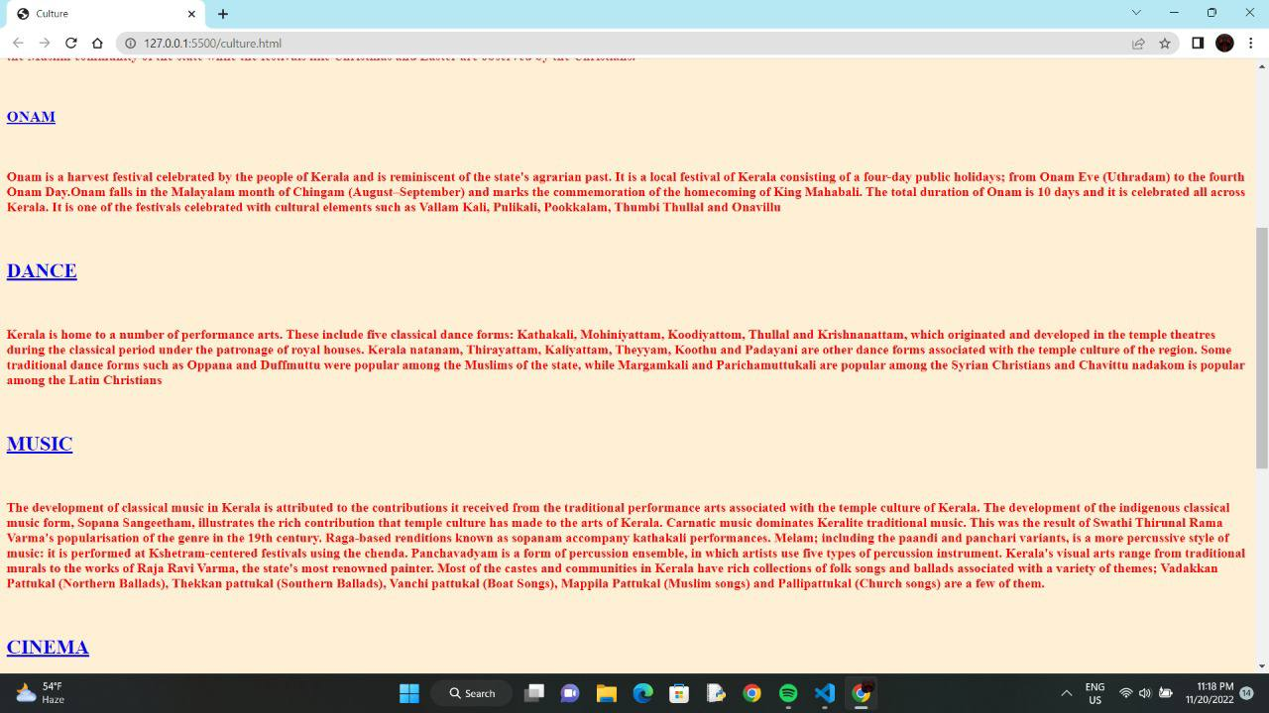

Slide 8
